Slide 1
Chaining Approval Processes with Apex Code
Andreina Mendoza
Senior System Business Analyst
@AndreinaMend17
Scott Coleman
Senior Software Application Engineer
@scottsalesforce

Slide 2

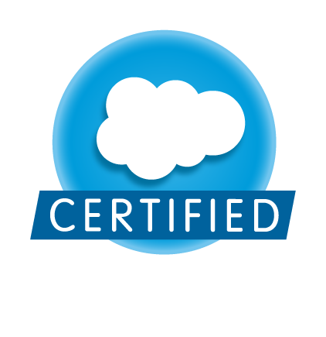
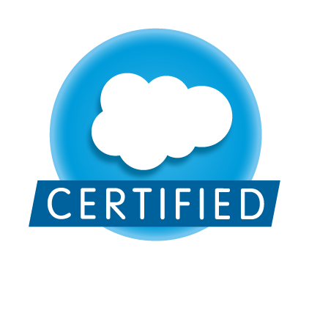
Andreina Mendoza
Senior System Business Analyst

Slide 3
Scott Coleman
Senior Software Applications Engineer

Slide 4
Agenda
Overview
Use Case: Chaining 2 Approval Processes
Business Problem / Solution
Demo
Use Case: Content Approval Process
Business Problem / Solution
Demo
Q & A

Slide 5

Overview
Why are Approval Processes important?
Challenges when building an Approval Process
Apex Code will add more flexibility and power

Slide 6
Chaining 2 Approval Processes using Apex Code

Slide 7

Use Case: Chaining 2 Approval Processes
Business Need / Problem
Red Hat Presales Engineers need to have access to free software when they need to built a Proof of Concept for a customer

Slide 8
Use Case: Chaining 2 Approval Processes
Business Flow
2nd Approval Process
Business Unit
1st Approval Process
NA Region – Final Step
Opportunity Status
Set to Pending BU Approval
Approved?
1st Approval Process
APAC Region – Final Step
YES
NO
1st Approval Process
EMEA Region – Final Step
YES
NO
Do this POC Opportunity
Needs BU Approval?
1st Approval Process
LATAM Region – Final Step
POC Approved
POC Rejected

Slide 9

Use Case: Chaining 2 Approval Processes
Code samples: http://gist.github.com/scottsalesforce
ChainPOCApprovals.trigger

Slide 10
Use Case: Chaining 2 Approval Processes
What else can you do?
Chain Approval Processes across multiple records and objects
Implement child processes that run while the parent process waits

Slide 11
SFDC Content Approval Process

Slide 12

Use Case: SFDC Content Approval Process
Business Need / Problem
Technical Engineers within Red Hat need the ability to add Content to a Technical Library, that is available to Red Hat Partners

Slide 13
Use Case: SFDC Content Approval Process
Business Flow
Contributed
Content Approved
Technical Engineer Upload Document and Save
SFDC CRM Content Record
Published
Contributed Content Record
YES
Global Marketing Receive Notification – Approval Process Begins
Contributed Content Record ‘s attachment
Approved?
NO
Submit for Approval
Contributed Content Rejected

Slide 14
Use Case: SFDC Content Approval Process
Code samples: http://gist.github.com/scottsalesforce
ContentTechnicalContributions.class
PublishContributedContent.trigger

Slide 15
Use Case: SFDC Content Approval Process
What else can you do?
Use Custom Object as proxy for Standard Objects in Approval Processes
When the Standard Object does not support approvals
When you want to avoid locking the main record
Submit for Approval using Apex can be used with many different objects
Upon approval you can easily trigger other changes in the system
Creation of records
Update to records even when there is no pre-existing relationship

Slide 16
Resources
Processing with Apex
https://www.salesforce.com/us/developer/docs/apexcode/Content/apex_process.htm
Approval Class
https://www.salesforce.com/us/developer/docs/apexcode/Content/apex_methods_system_approval.htm
Code Samples
https://gist.github.com/scottsalesforce
Andreina Mendoza
@AndreinaMend17
Scott Coleman
@scottsalesforce
Chatter Feed
https://success.salesforce.com/Ev_Sessions#/session/a2q30000000guoWAAQ

